Slide 1
ECE 313: PROBABILITY WITH ENGINEERING APPLICATIONS
Fall 2023
Prof. Eric Chitambar
Lecture 26

Slide 2

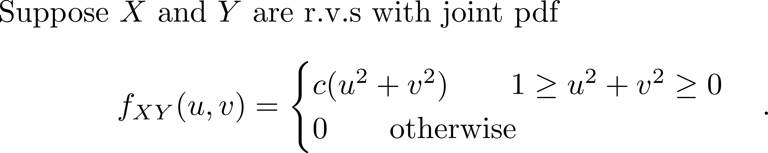

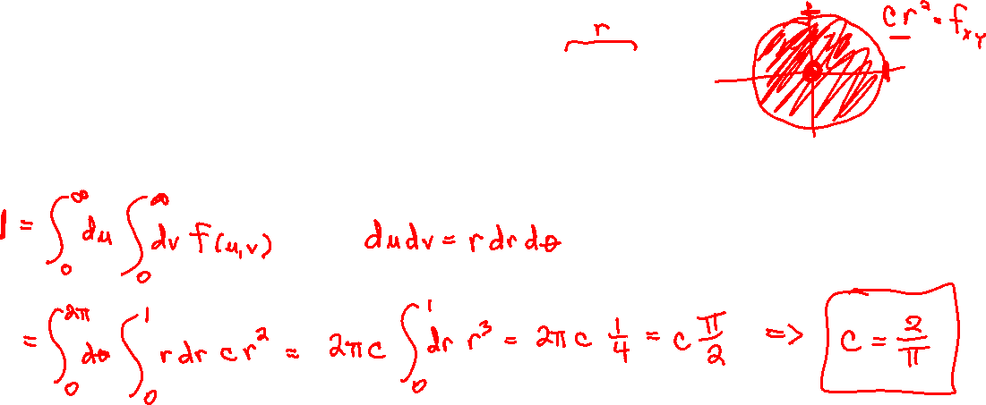
The Conditional pdfs

Slide 3
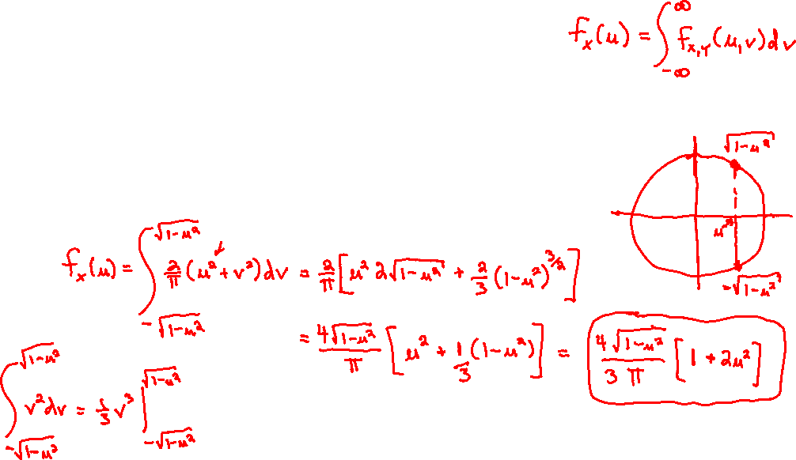
The Conditional pdfs

Slide 4
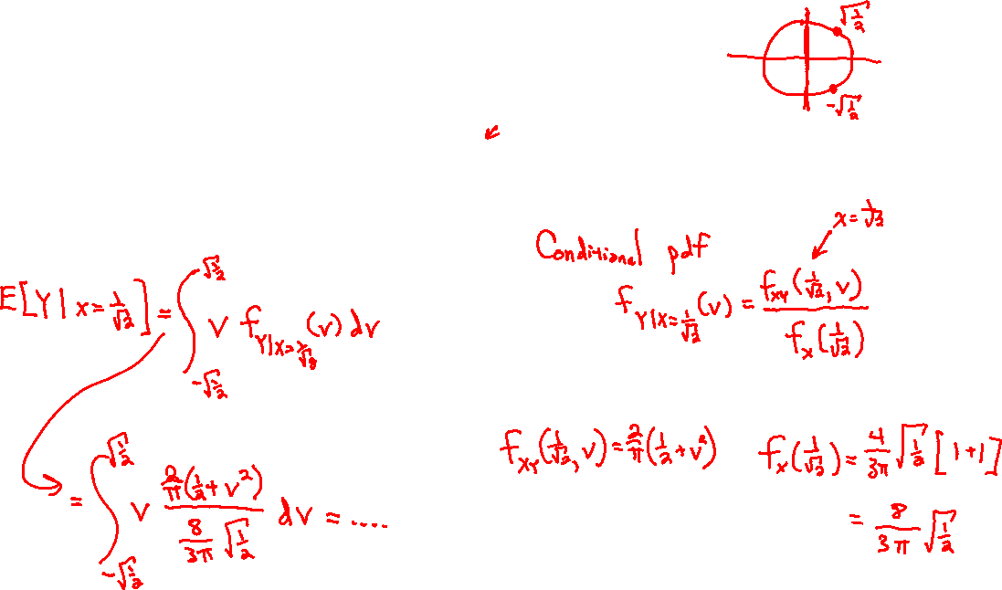
The Conditional pdfs

Slide 5
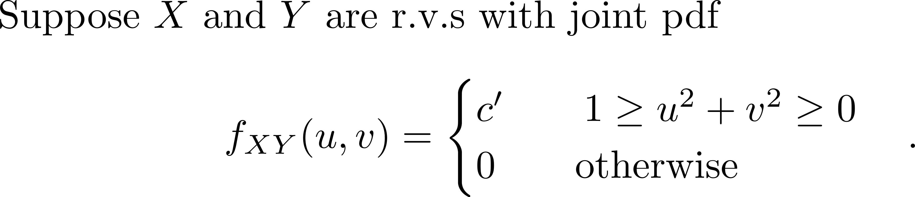
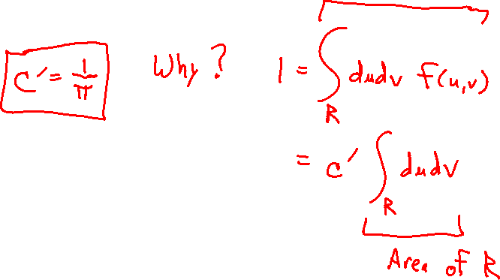
More Examples of Joint pdfs

Slide 6
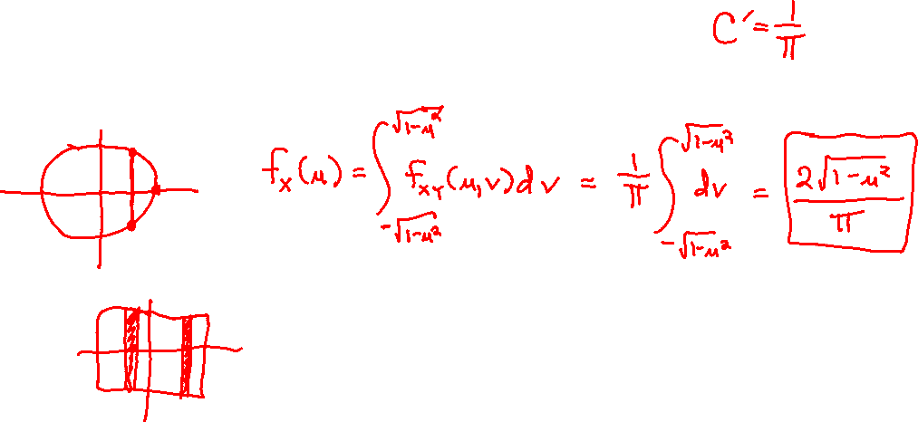
More Examples of Joint pdfs

Slide 7
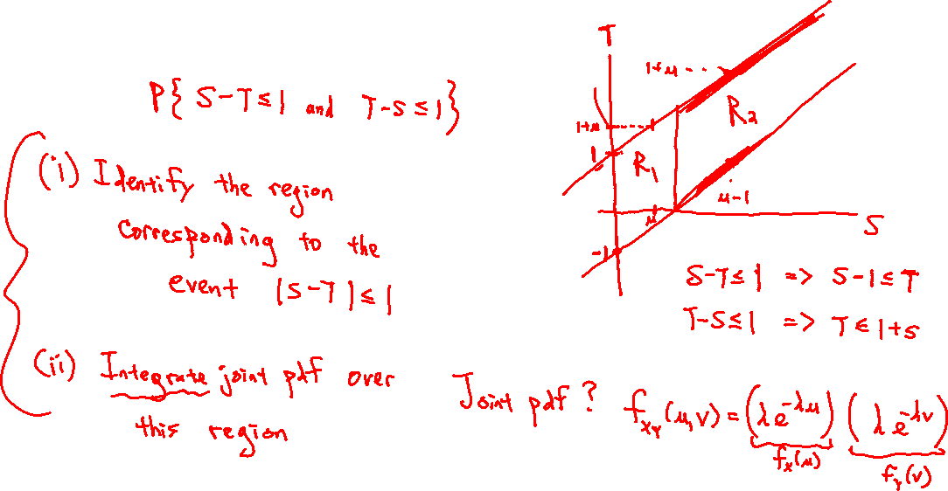
More Examples of Joint pdfs

Slide 8
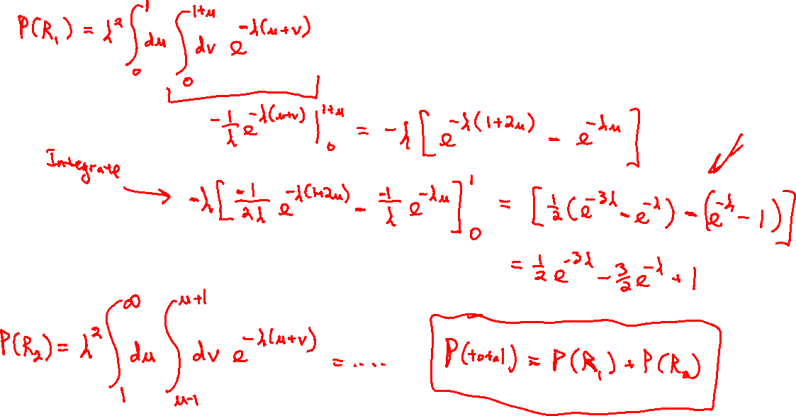
More Examples of Joint pdfs

Slide 9

More Examples of Joint pdfs

Slide 10

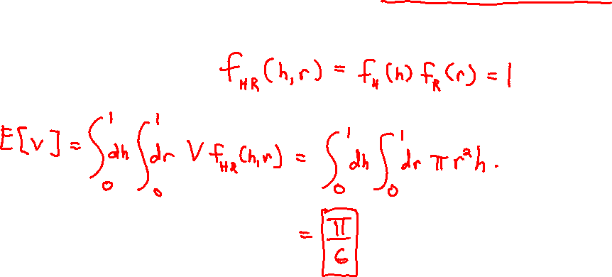
More Examples of Joint pdfs

Slide 11
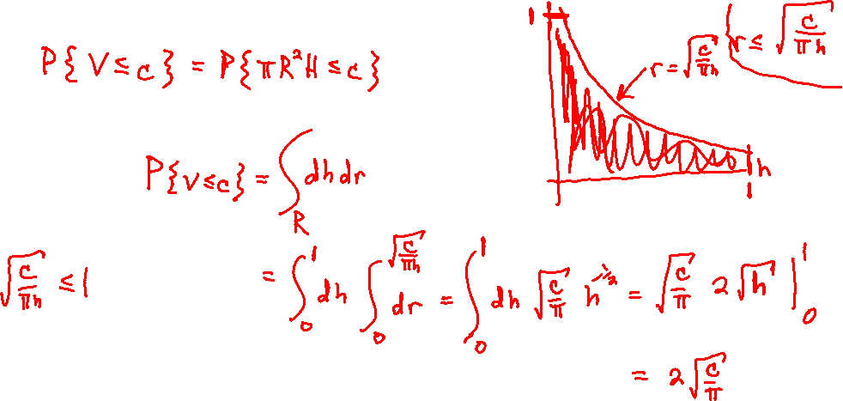
More Examples of Joint pdfs

